Slide 1
Supporting Mental Health in Tech Workplaces Saurav Jadhav

Slide 2
agenda
INTRODUCTION 3
Key Insights 4
Recommendations 9
Conclusion 6
Appendix 11

Slide 3

Introduction This dataset is from a 2014 survey that measures attitudes towards mental health and frequency of mental health disorders in the tech workplace.
This Photo by Unknown Author is licensed under CC BY

Slide 4

Key Insights

Slide 5
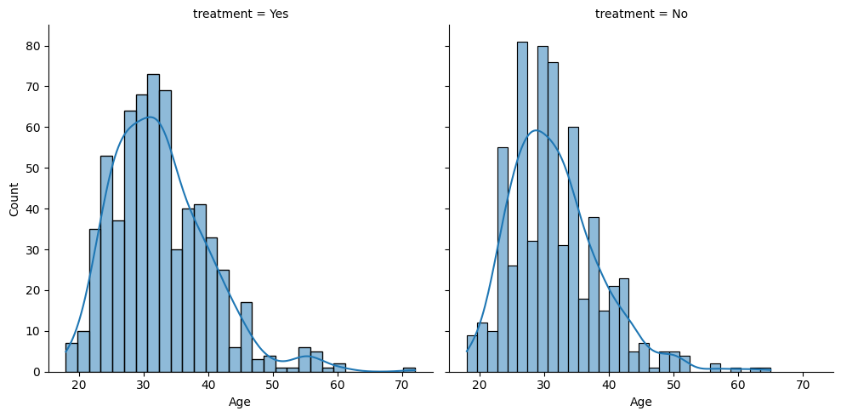
Does Age have an impact on Mental Health?
The age distribution indicates people with age>30 are less likely to get the treatment.

Slide 6
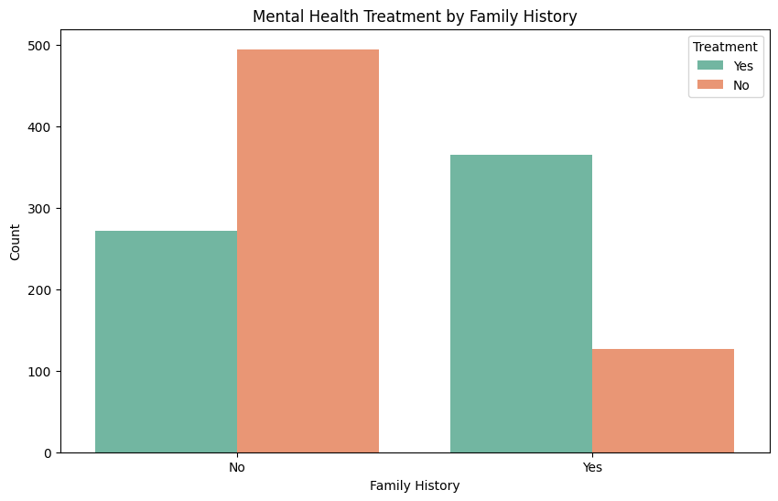
Does the family history affect the people seeking treatment?
Employees with family history are more aware and more likely to seek help.

Slide 7
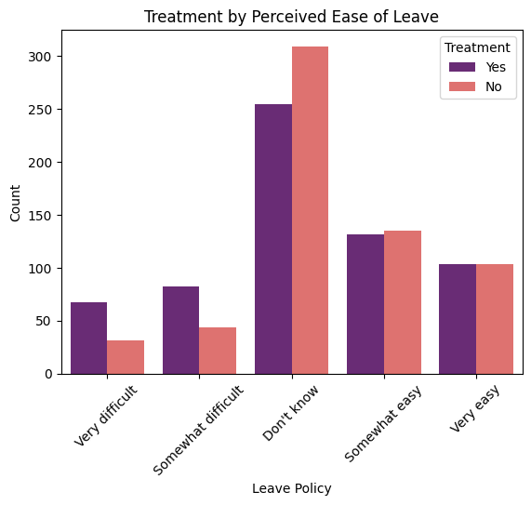
Is there any inclination on seeking treatment based on the leave policy?
Leave policy is the indication of how much the company cares for the employees.
We can observe that where there’s difficulty in getting leaves, more employees are seeking treatment.

Slide 8
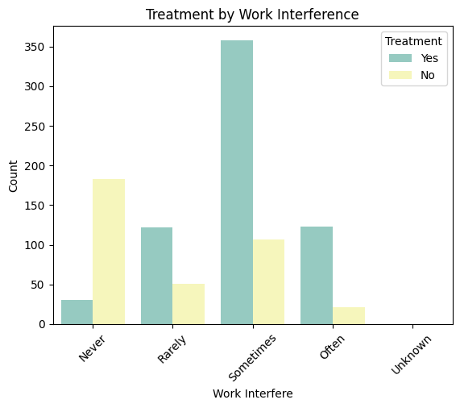
Does more work interference implies more employees seeking treatment?
From the plot we can suspect that, employees with more work interference are more inclined towards seeking treatment.
In fact we can also observe the contrary, the employees whose work is never interfered are highly unlikely to seek treatment.

Slide 9
Recommendations

Slide 10
Key Recommendations
More Freedom at Workplace
Monitor and support employees where mental health interferes with work.
Offer flexible schedules and mental health days.
Promote Awareness and Reduce Stigma
Run campaigns to normalize mental health treatment.
Highlight leadership support for mental well-being.
Enhance Access to Care
Provide clear care options, counseling services, and benefits.
Simplify the process to request leave for mental health reasons.
Foster a Supportive Culture
Encourage manager training to recognize and respond to mental health needs.
Develop policies that explicitly state no negative career impact for seeking treatment.

Slide 11
Additional Recommendations
Ensure small teams and startups have equal access to mental health resources.
Provide anonymous external support options where internal HR is limited.

Slide 12
thank you

